Slide 1


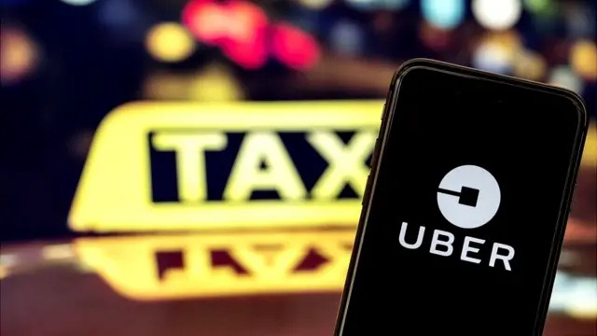
THE QUEST FOR LEGITIMACY IN DIGITAL DISRUPTION: THE CASE OF UBER (A)
EXPLORING UBER'S GROWTH, CHALLENGES, AND FUTURE STRATEGIES
Presented By: GROUP 1
Swathi Manjunatha
Hariharan Sachidanandam

Slide 2
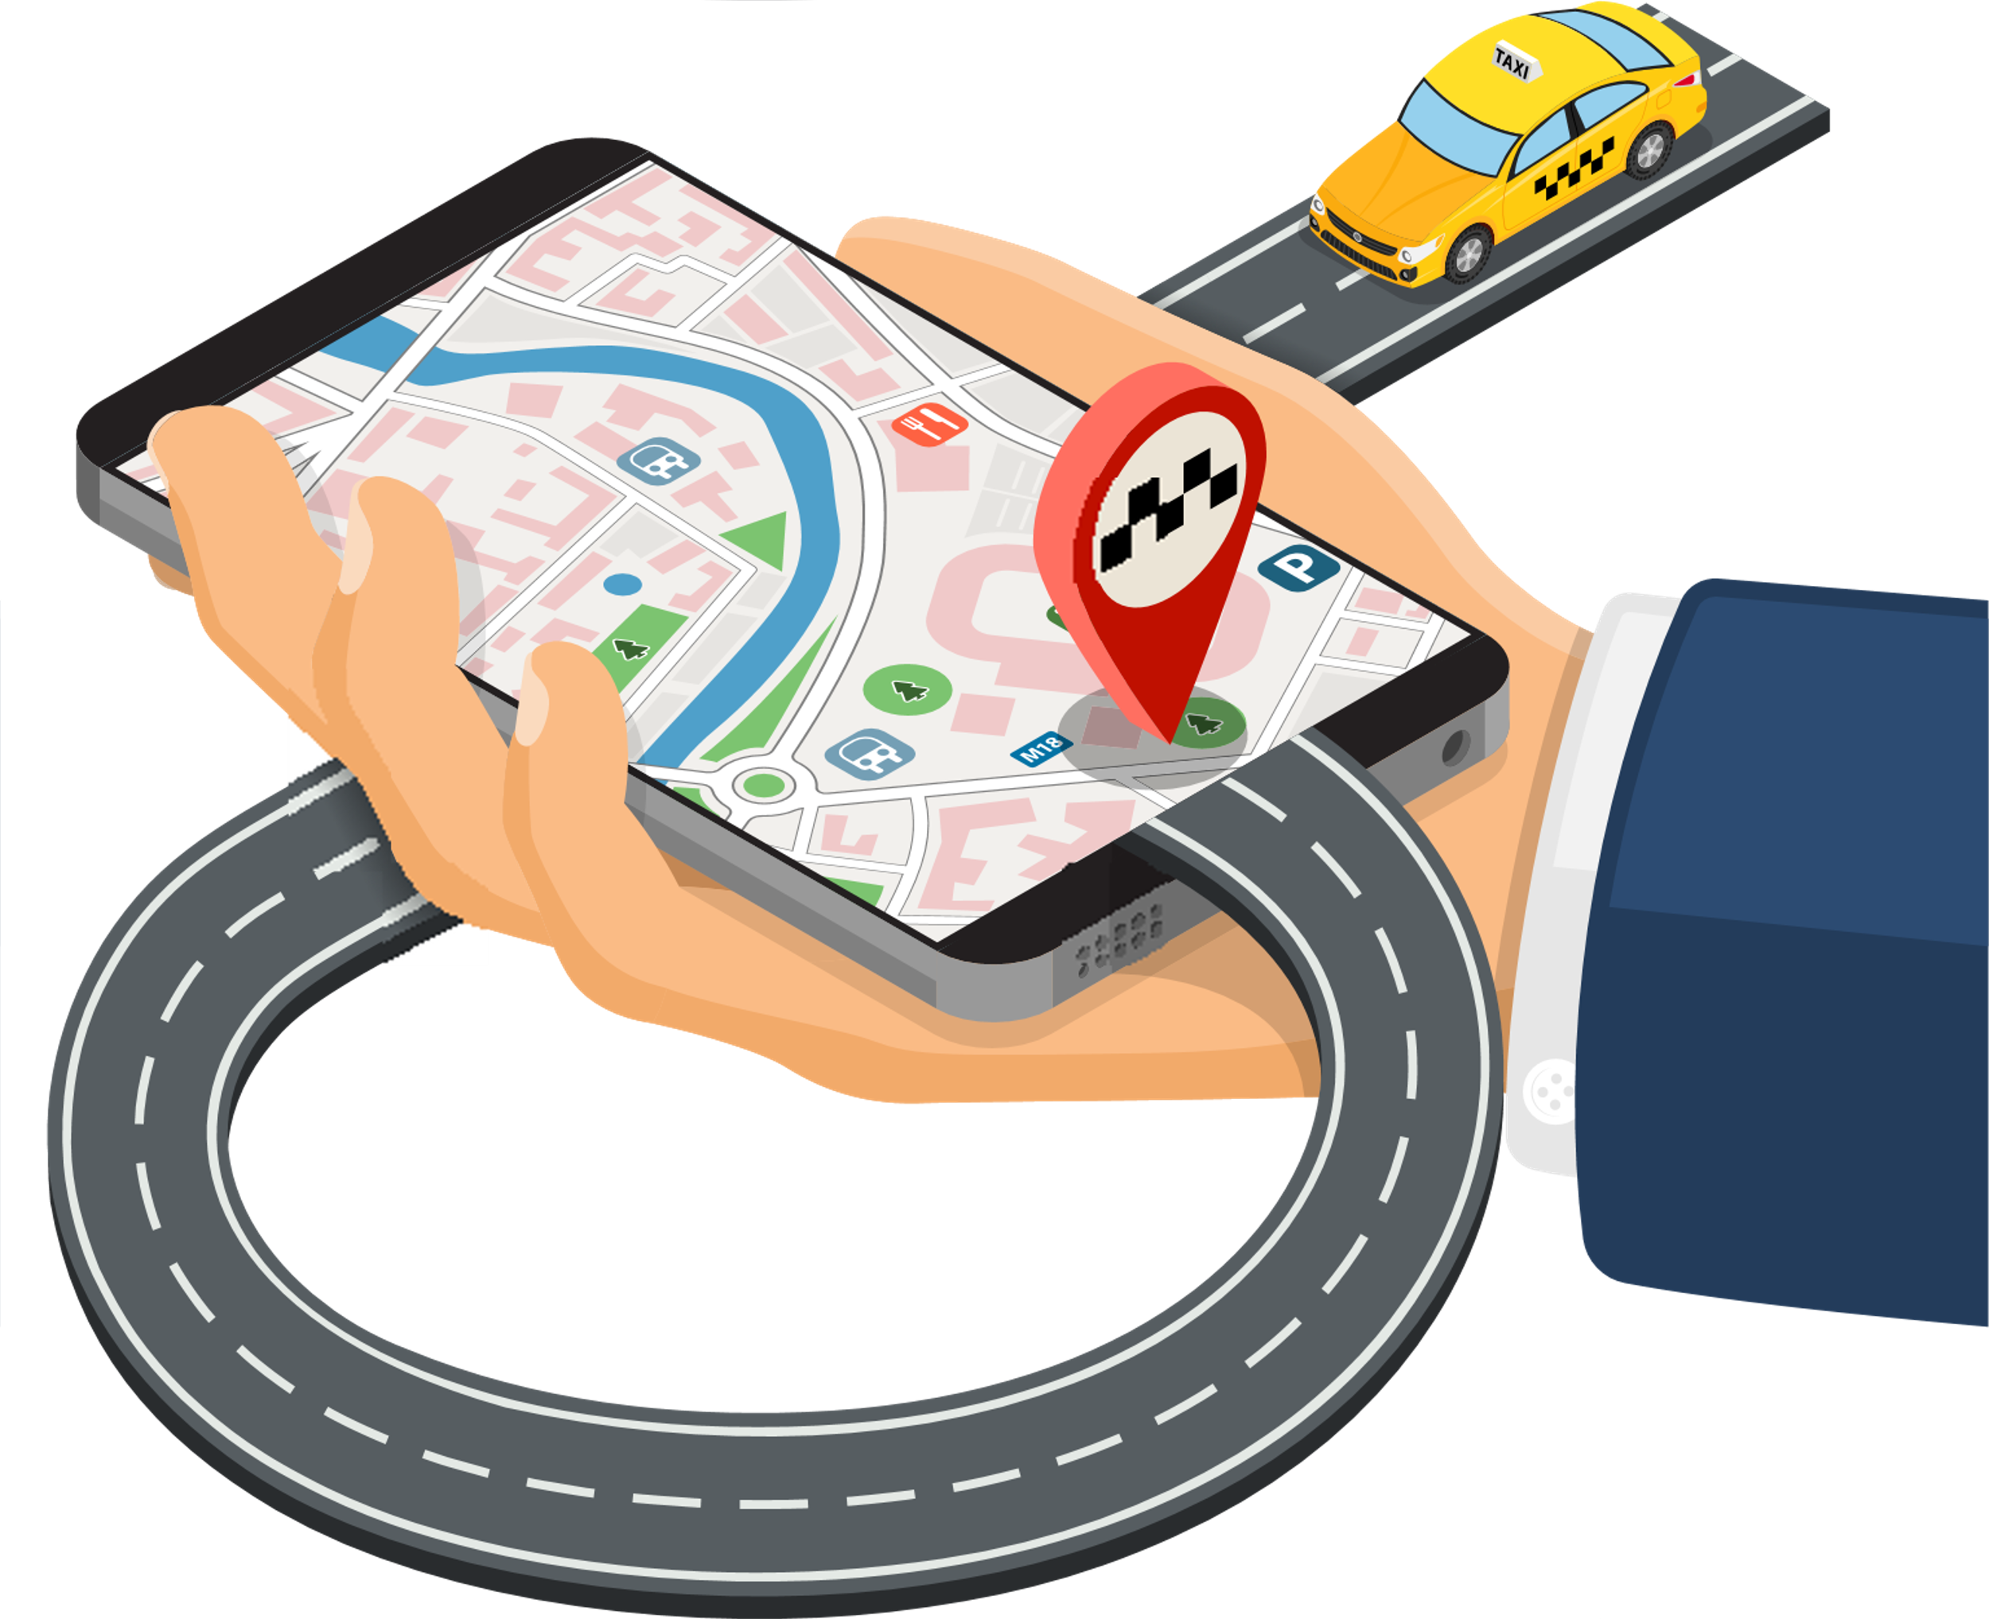


AGENDA
TOPICS COVERED
01
02
03
04
05
06
Company Overview
Two-side Marketplace
Business Model
SWOT Analysis
Regulatory Challenges
Market Entry Strategies
07
08
09
10
Evolving Regulatory Landscape
Tackling Major Challenges
Future Strategies
Conclusion

Slide 3
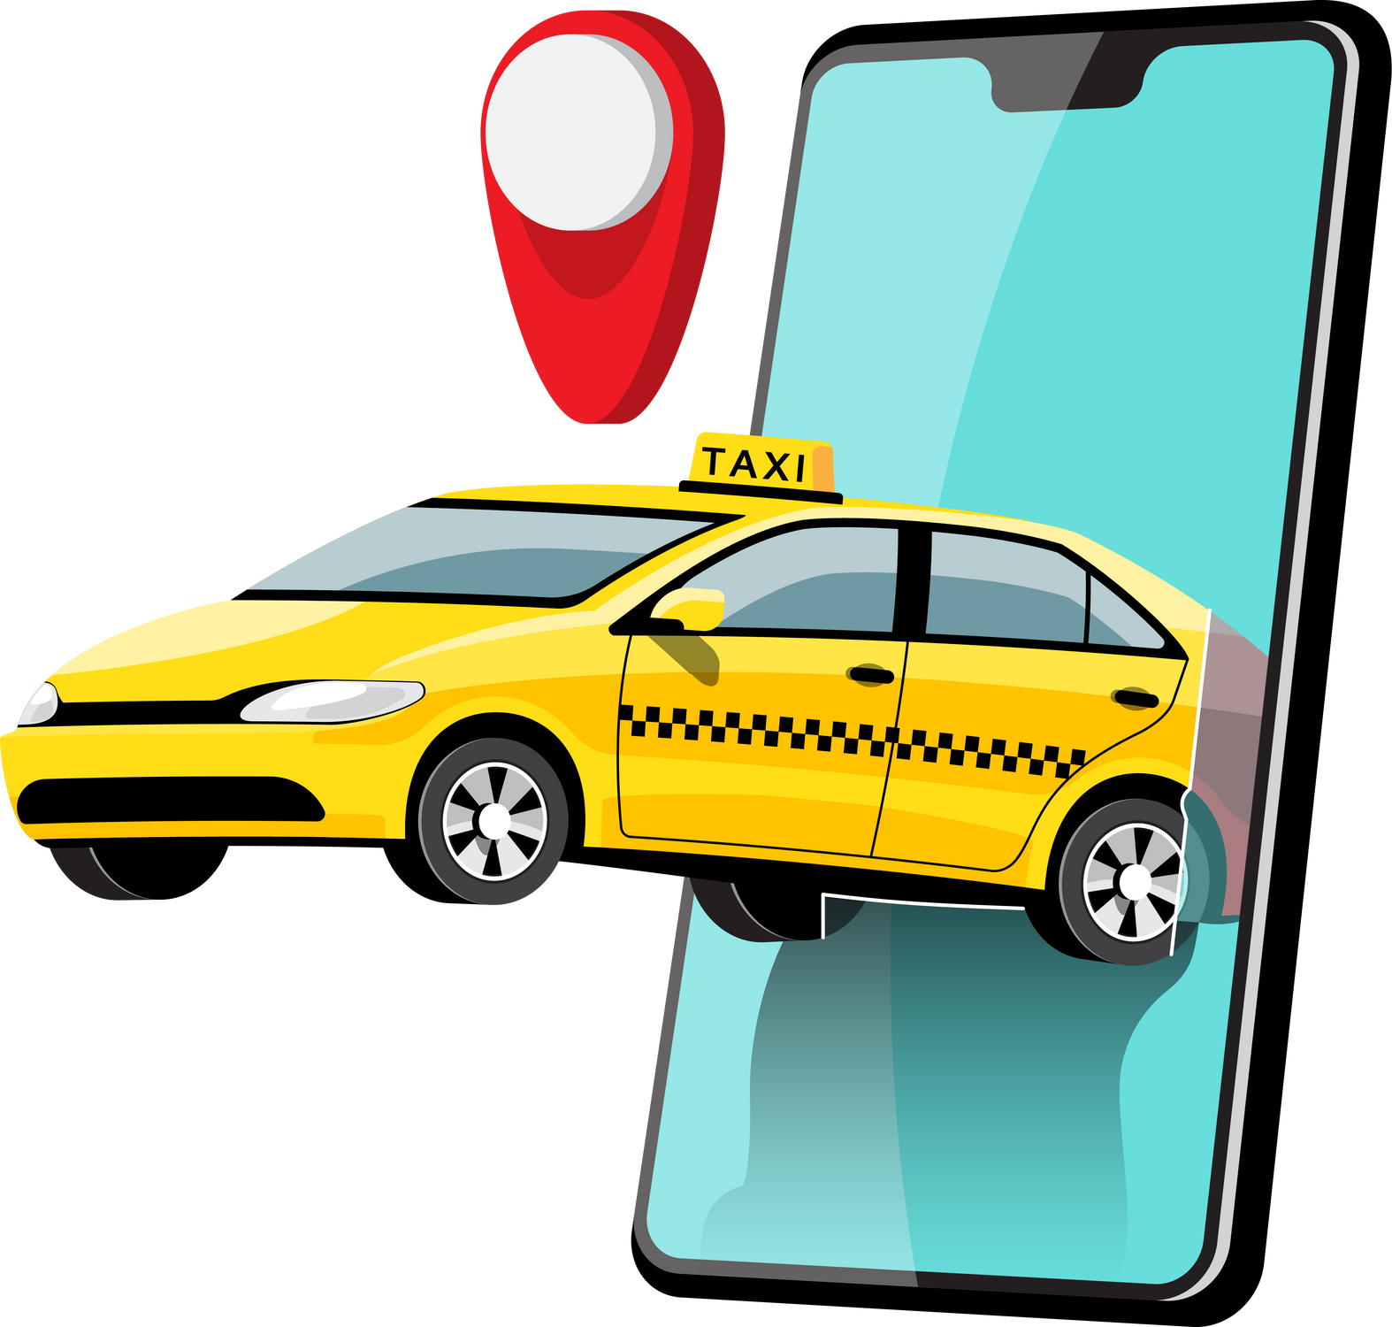





UBER OVERVIEW
Founded in 2009 by Garrett Camp and Travis Kalanick in San Francisco.
Revolutionized transportation through
- convenience, accessibility, and affordability.
Disrupted the taxi industry with a smartphone
app linking passengers and drivers.
Operates in 70 countries and over 10,500 cities globally.
Listed in Fortune 500 by 2016.
Achieved 2 billion rides in 7 years.
Current market cap: $144.37 billion; 114th most valuable company globally
Main funders: Google Ventures, Morgan Stanley, and Microsoft.

Slide 4


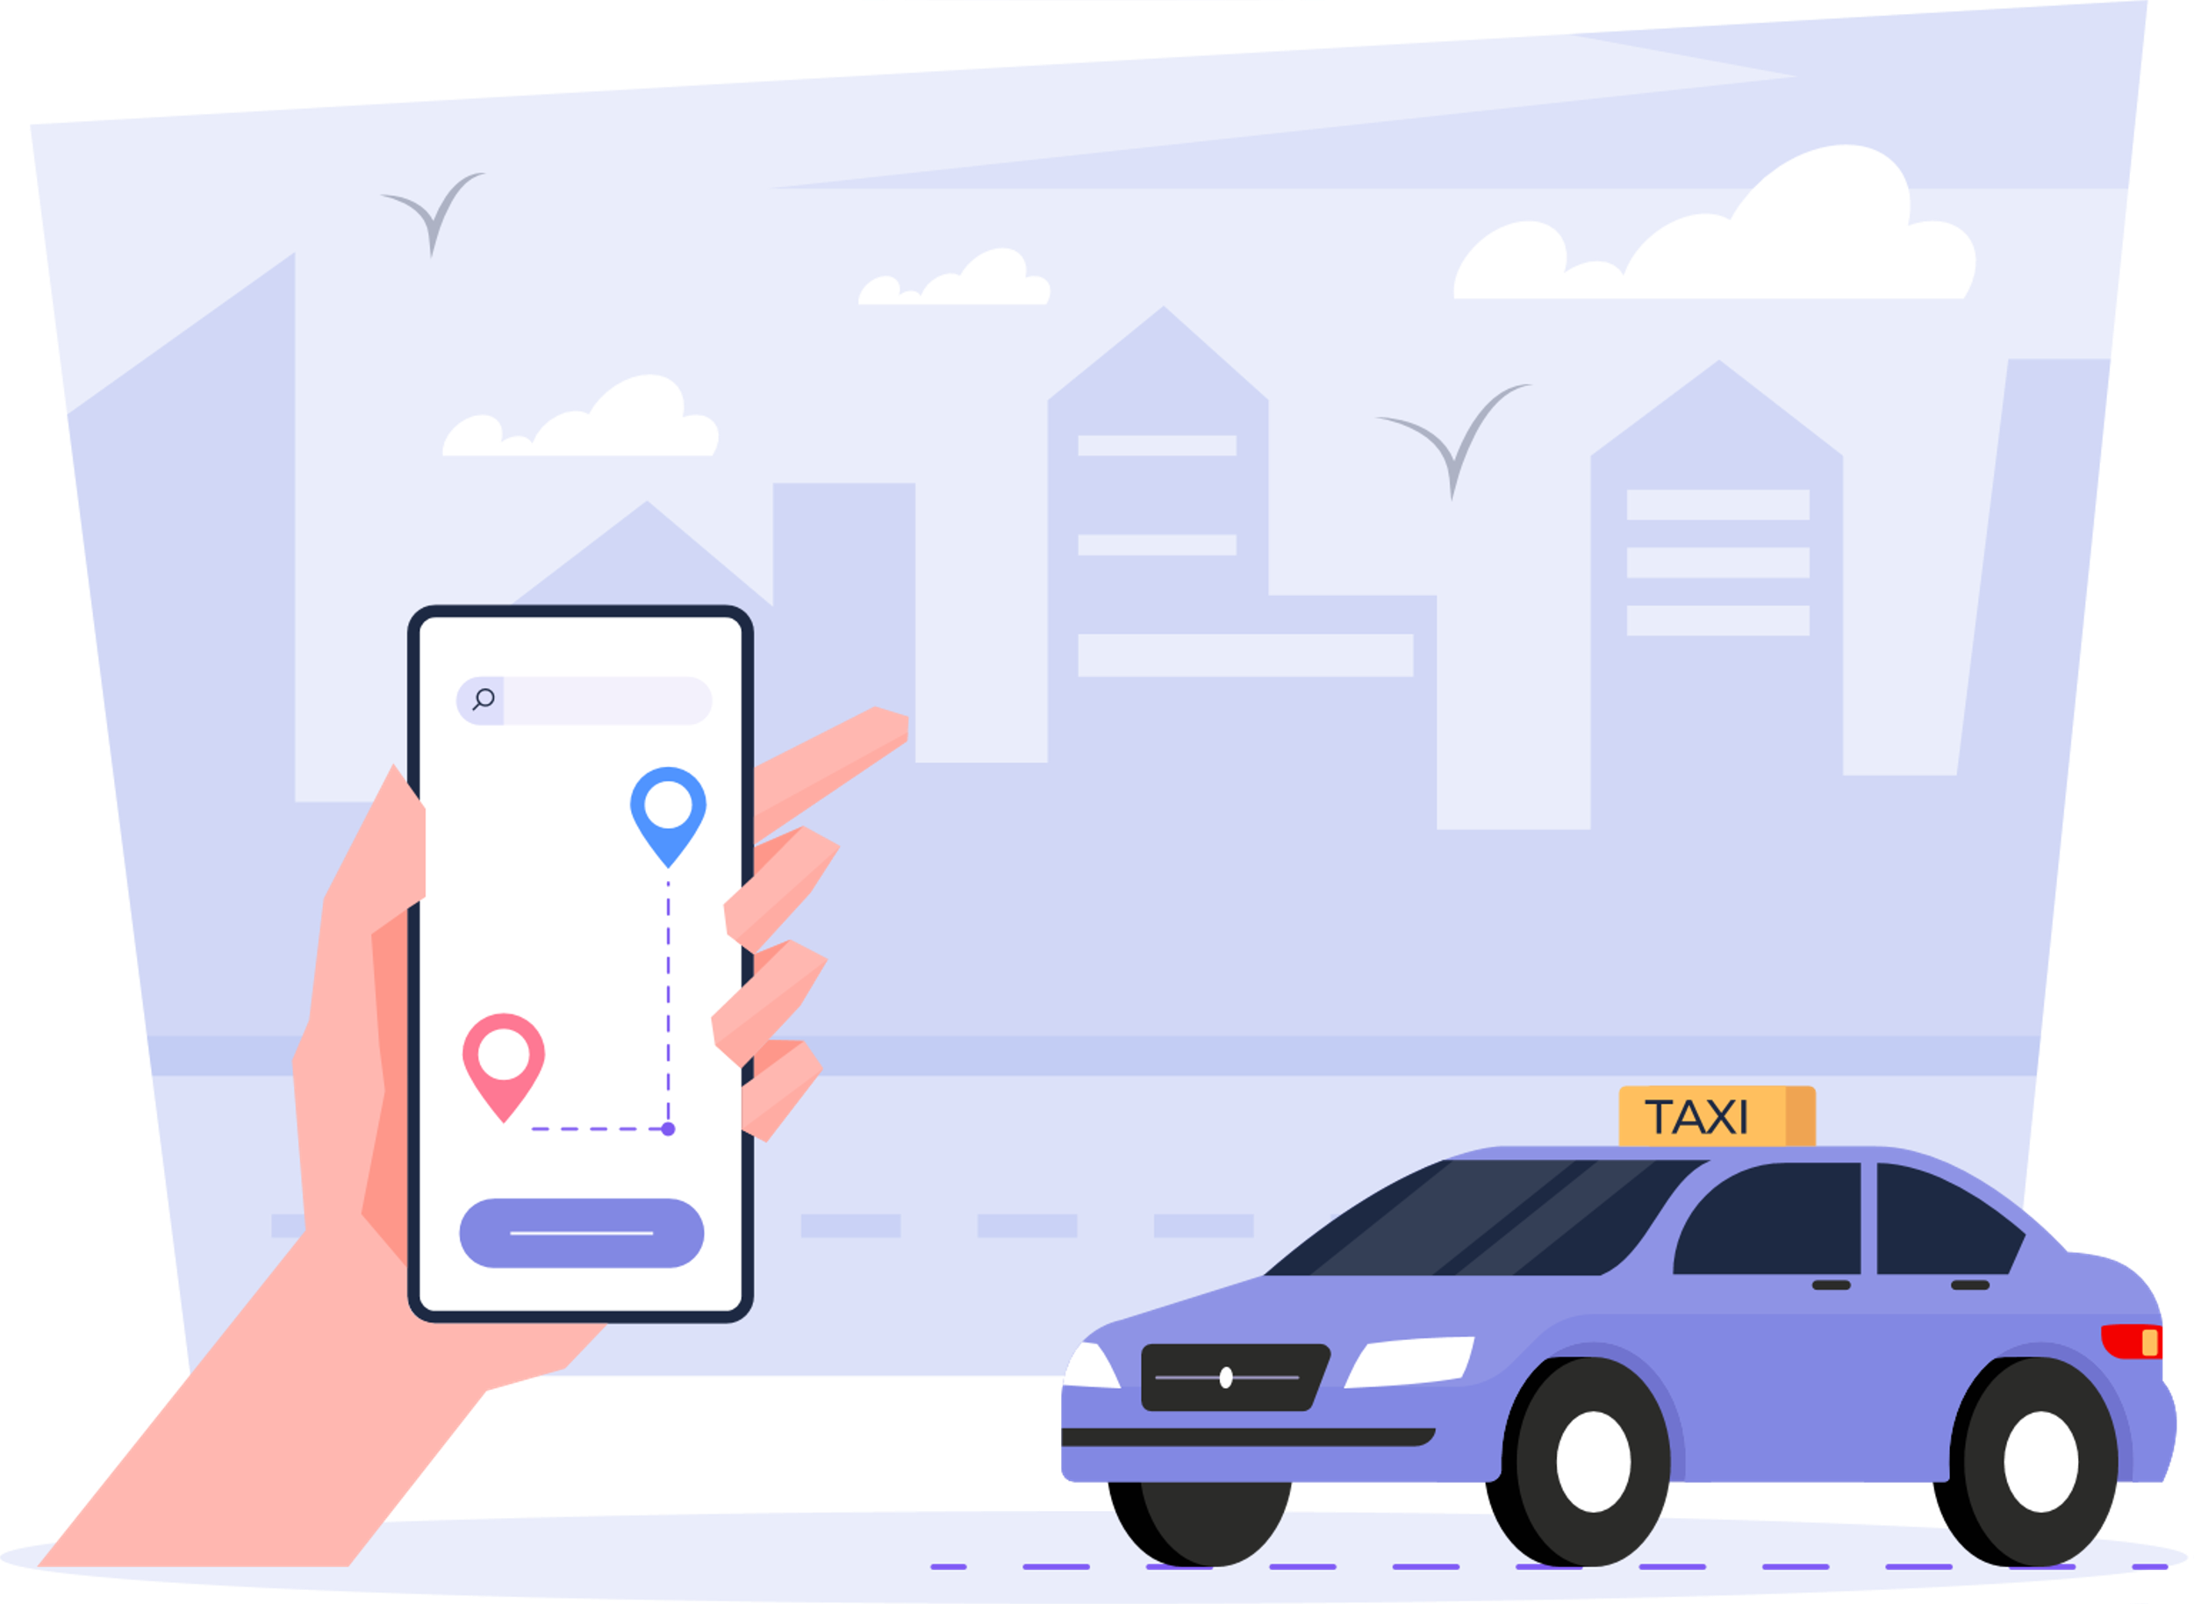
UBER: DISRUPTING THE TAXI INDUSTRY​
PROBLEMS
Difficulty finding taxis in Paris.
Severe taxi shortages in cities.
Insufficient taxi medallion issuance despite population growth.
Increasing customer dissatisfaction due to limited cab availability.
Uber is a prominent unicorn tech startup that exemplifies the idea of "move fast and break things." It has disrupted the traditional taxi industry with its smartphone app, easily connecting passengers and drivers.
UBER’S APPROACH
Made transportation reliable and accessible.
Reduced taxi medallion prices for better accessibility.
Enhanced customer satisfaction through app convenience.
Employed technology for a smooth ride-hailing experience.

Slide 5

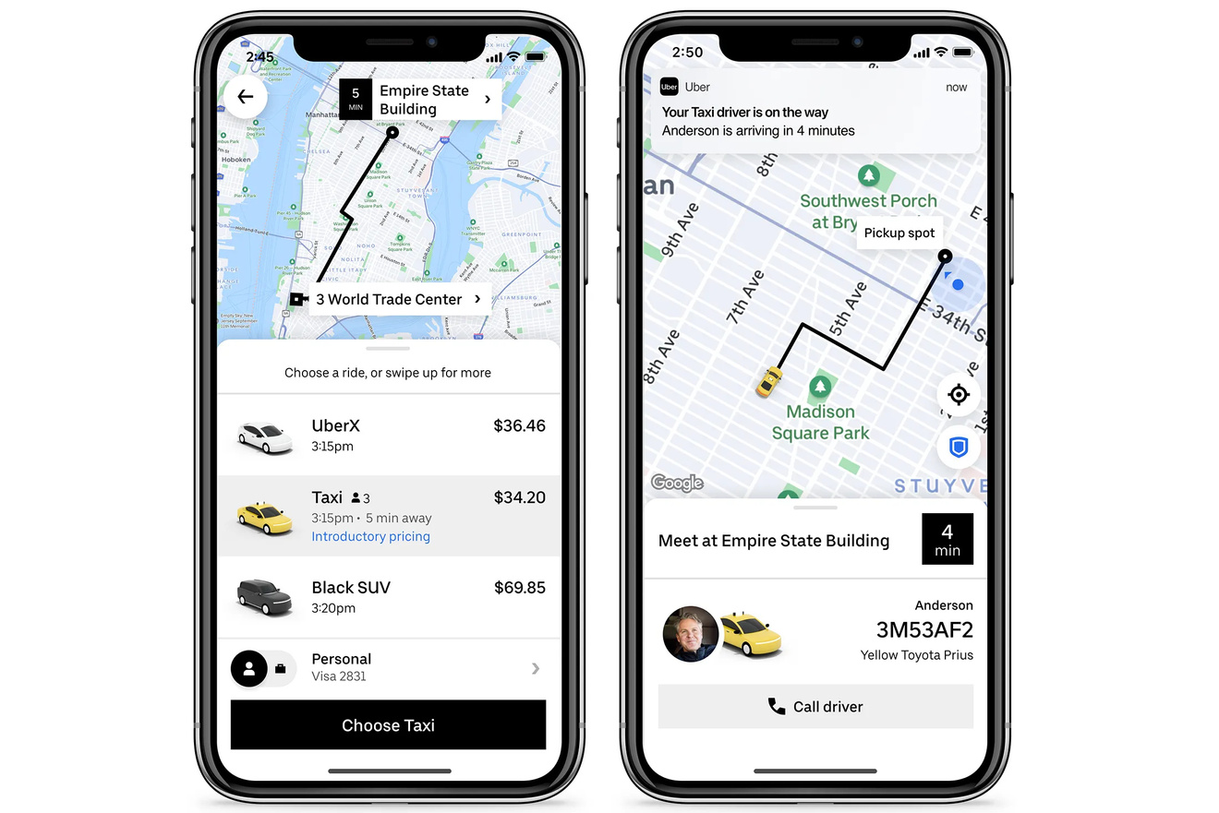


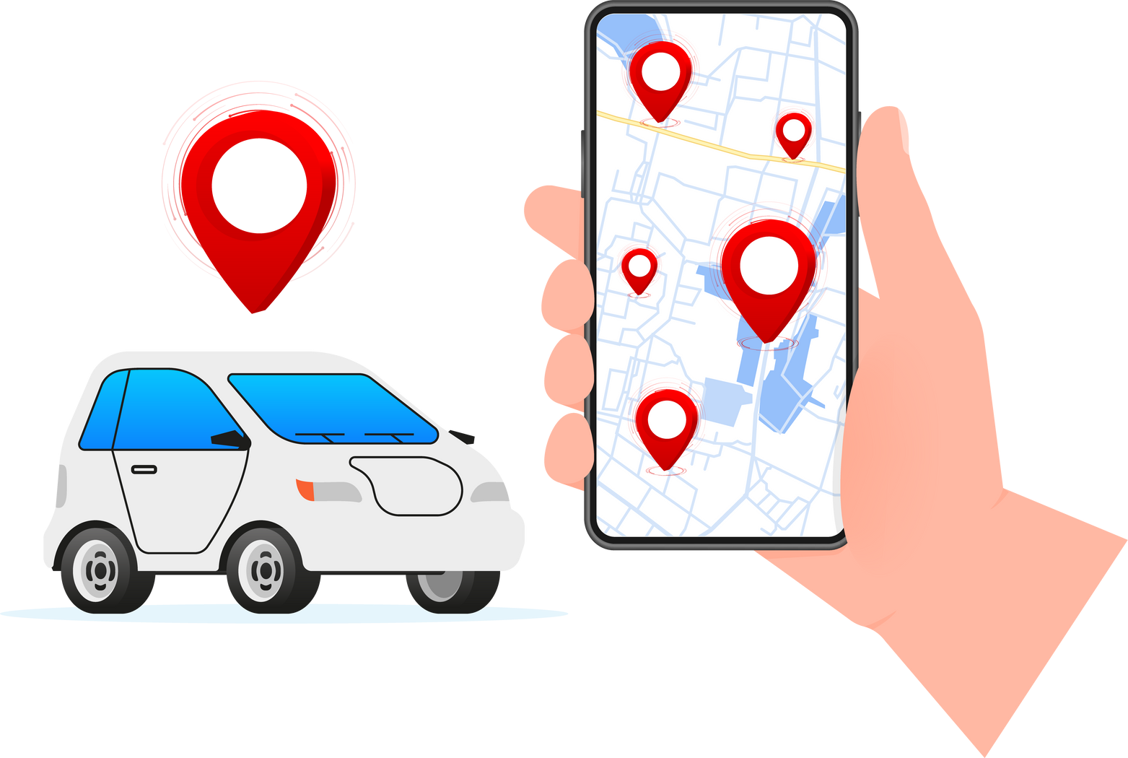
FOR CUSTOMER
HOW UBER WORKS ?
Download the app and set up an account with payment info.
Choose a ride option (UberX, UberPool) and see nearby drivers.
Confirm the fare and book the ride.
Optionally contact the driver for coordination.
Fare is automatically deducted, and a receipt is emailed after the ride.
FOR DRIVER
Receive ride requests via the app and accept/reject based on preference.
Use heat maps to locate high-demand areas.
Optionally contact the customer for coordination.
Complete the ride and press
"End Ride" to finalize.
Earnings are credited directly
to the driver’s account.

Slide 6

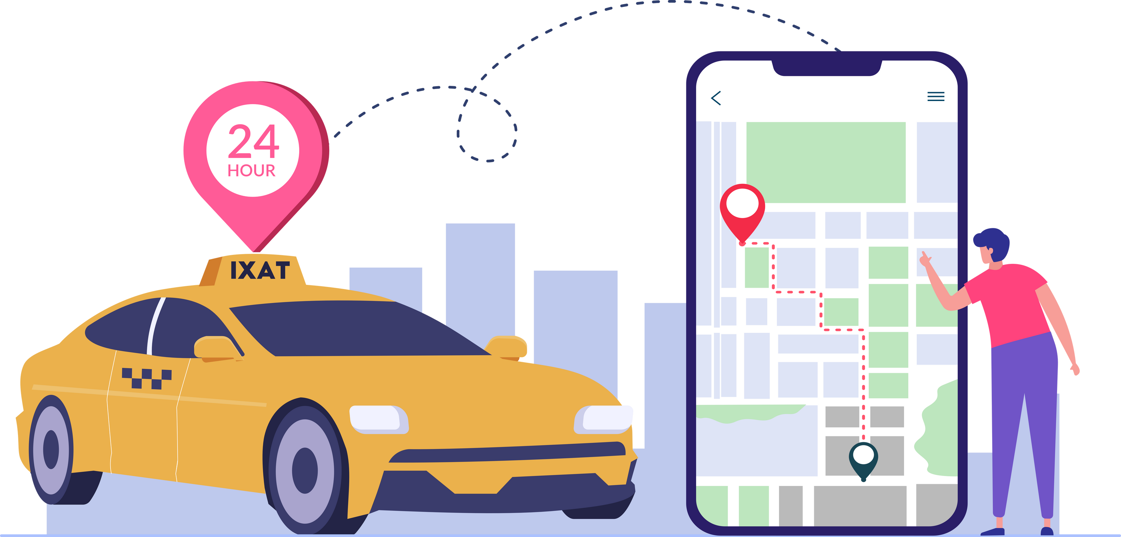

WHAT IS TWO-SIDE MARKET PLACE ?
UBER’S COMPETITIVE EDGE
Business model that connects two distinct user groups riders and drivers.
Faster Market Penetration
Enhanced Service Availability
User Loyalty
Optimization
Adaptability to Local Markets
UBER’S TWO-SIDED MARKETPLACE FEATURES
Network Effects
Dynamic Pricing
Asset- Light Model
Global Scalability
Real-Time Matching
Trust and Ratings System

Slide 7


COMPARISON WITH TRADITIONAL MARKETPLACES - AMAZON, GOOGLE
ASPECT | SIMILARITIES | DIFFERENCES
CORE STRUCTURE | Connects two user groups. | Operates in real-time, location-based.
NETWORK EFFECTS | Growth attracts users on both sides. | Driver supply fluctuates dynamically.
TRUST MECHANISM | Built through reviews and ratings. | Focus on safety and real-time trust.
REVENUE MODEL | Earns commission on transactions. | Dynamic pricing adjusts fares instantly.
REGULATIONS | All face regulatory oversight. | Stricter labor and transport laws.

Slide 8
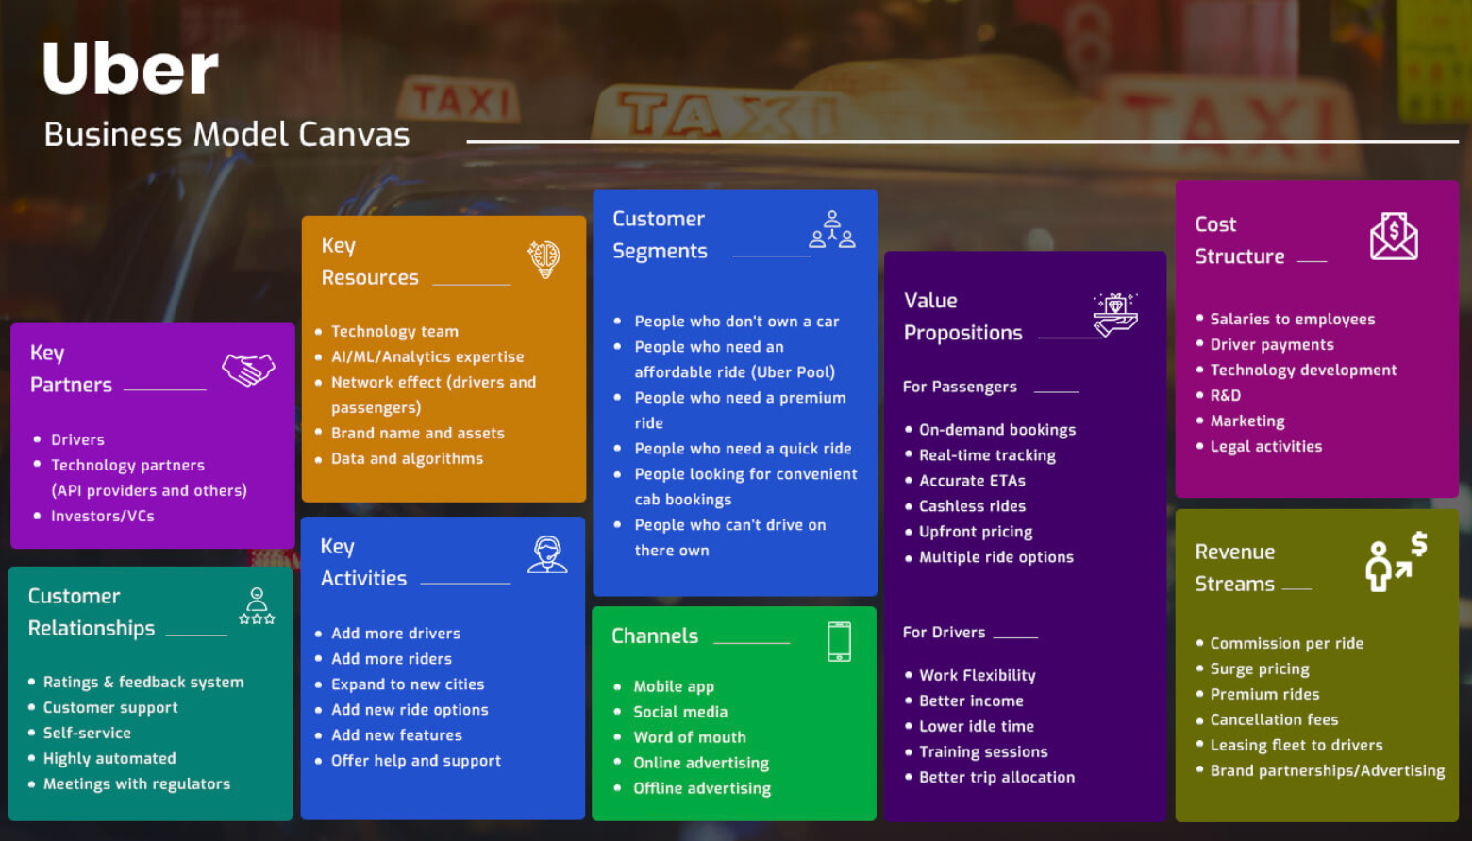
Body

Slide 9



SWOT ANALYSIS
STRENGTHS
WEAKNESSES
User-friendly app-based platform.
Cashless payment system.
Lower prices
High service standards.
Low operational costs.
The concept is easily replicable.
There are ongoing regulatory and legal challenges.
Driver dissatisfaction arises from wages and contractor classification.
Public criticism focuses on surge pricing and safety concerns.
OPPORTUNITIES
THREATS
Expand into emerging markets with urban growth.
Increase food delivery and freight logistics services.
Utilize AI and data analytics for operational efficiency.
Collaborate with autonomous vehicle technology firms.
Intense competition from Lyft and other local and new entrants
Stricter regulations and labor laws in various markets
Negative public perception due to controversies
Risk of data breaches and evolving cybersecurity threats

Slide 10







REGULATORY CHALLENGES
REGULATORY CONTRAVENTIONS
ANTITRUST CONCERNS
Early protests from regulators and taxi associations due to:
Inadequate driver background checks and training
Lack of vehicle inspections and proper insurance
Bans or severe restrictions in cities like Paris, Berlin, and NY
Uber faced antitrust allegations for disrupting taxi markets.
Traditional companies accused Uber of predatory pricing to eliminate competition.
California's Public Utilities Commission expressed concerns about Uber's pricing impact on traditional taxis.
TAXI UNION PROTESTS
Taxi unions claim Uber unfairly competes by:
Skipping licensing rules and medallion fees.
Disrupting fair competition for traditional taxis.
Large-scale protests by taxi drivers occurred in London and Berlin.
OUTDATED REGULATIONS
Uber challenged outdated taxi regulations that stifled innovation.
It argued existing laws didn't support tech-driven ride-sharing.
Cities like Austin reevaluated their policies for ride-hailing services.
LICENSING AND OPERATIONAL RESTRICTIONS
Cities have implemented laws restricting Uber drivers.
Miami's fingerprinting requirement raised operational challenges.
Many areas initially banned Uber airport pickups and drop-offs.

Slide 11




MARKET ENTRY STRATEGY
EXPANDING
MOBILIZING
LEGAL TACTICS
Leveraged social media to mobilize public support
Faced over 70 lawsuits globally in its first five years, using legal battles to challenge outdated laws.
Entered markets before regulations were established
Positioned itself as a tech platform, not a taxi service, to bypass strict licensing laws.
EVOLVING REGULATORY LANDSCAPE
REGULATIONS
LOBBYING
SUPPORT
Initial resistance from regulators led to evolving laws accommodating ride-sharing platforms.
Uber hired David Plouffe, former Obama campaign manager, in 2014 to influence policy-making.
Modernalized Regulations
Highlighted public benefits like reduced drunk driving and job creation to gain support.

Slide 12




TACKLING OTHER CHALLENGES
Surge Pricing and Fare Transparency
SAFETY AND PRIVACY CONCERNS
INSURANCE & DRIVER CLASSIFICATION
COMPETITION
Insurance gaps during "period-1" when drivers were logged in but not active.
Drivers use their own vehicle to provide rides
Classification of drivers as contractors led to protests over lack of benefits.
Purchased primary third-party liability insurance for drivers during "period-1."
Piloted benefits programs and clarified driver policies to improve relations.
Criticism for exploiting demand with dynamic pricing.
Customer dissatisfaction due to unclear fare calculations.
Fares surged 4x during the Sydney hostage crisis.
Enhanced fare transparency by displaying tolls, traffic, and surge costs upfront.
Restricted surge pricing during emergencies to minimize backlash.
Scrutinized for inadequate driver background checks and privacy issues.
Data breaches exposed 57 million records in 2016, raising trust issues.
Introduced stringent driver background checks and real-time identity verification.
Hired privacy experts, implemented stronger encryption, and simplified privacy policies.
Rivalry with Lyft, Ola, Grab, and Didi Chuxing impacted market share globally.
Lost significant traction in China to Didi Chuxing, leading to an eventual merger.
Merged operations with competitors like Didi in China.
Diversified offerings with Uber Eats and Uber Freight to tap new revenue streams.

Slide 13


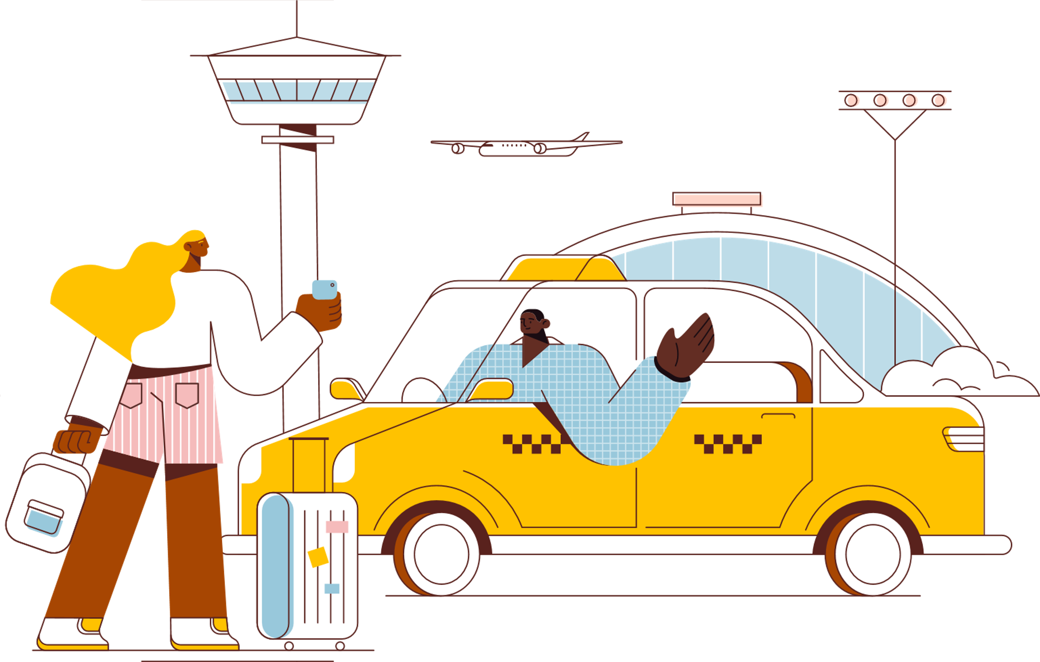
FUTURE STRATEGIES
Core Services Improvement
Expanding into Emerging Markets
Investing in Technology
Diversification of Offerings
Aligning with Regulations

Slide 14



CONCLUSION
UBER'S IMPACT:
Transformed global transportation and disrupted traditional industries.
Established the gig economy model, affecting various sectors.
KEY TAKEAWAYS:
Innovation: Key strengths are adaptability and technology-driven methods.
Challenges:Faces regulatory, competitive, and public perception issues.
LOOKING AHEAD:
Sustainability and compliance are crucial for Uber's future.
Growth hinges on innovation in autonomous technology and service diversification.
FINAL THOUGHT:
Uber's success relies on balancing disruption with responsibility and collaboration.

Slide 15

CASE QUESTIONS
1. What exactly is the competitive edge that Uber has, that enables it to disrupt the taxi industry?
2. Is Uber a taxi company or a technology company? What exactly is Uber’s business model?
3. How is Uber similar to traditional two-sided online marketplaces, e.g., Google (online marketplace for information), Amazon (online marketplace for goods)? What are critical success factors for a two-sided online marketplace?
4. How is Uber different from these traditional two-sided online marketplaces? What are the additional complications due to these differences?
5. Where do you stand in the controversies surrounding Uber’s disruption of the taxi industry? Justify.

Slide 16

Questions

Slide 17


